Slide 1
Inuktitut uqausituqarinngitamnik ilinniaqpalliajunga qablunaat nunangani Inuktitut second language (ISL) learning in an urban setting:
a first-hand account
Anna Logie

Slide 2
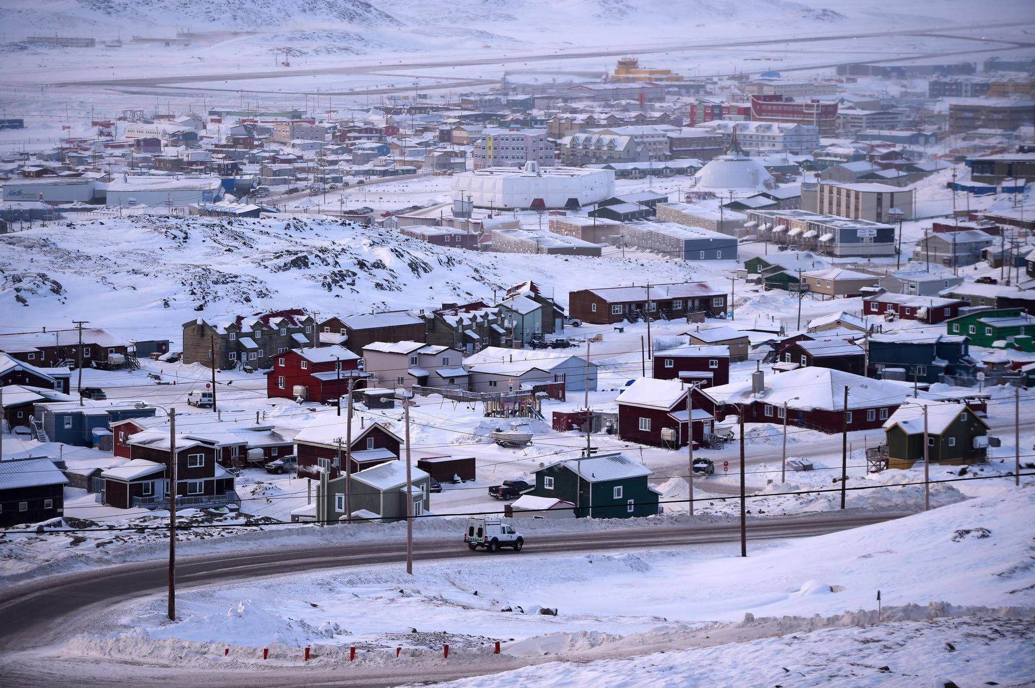
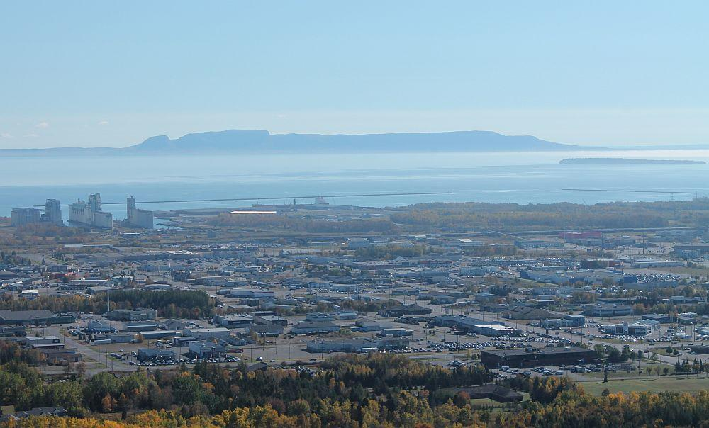

Slide 3
big question
What pedagogical methods and goals did I choose to make the learning process easier for me as an ISL learner in an urban environment?

Slide 4
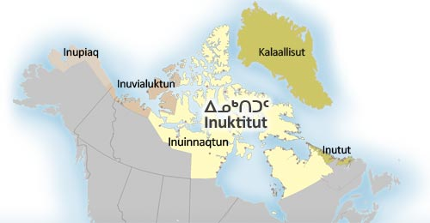
http://www.tusaalanga.ca/node/2502
Thunder Bay X
Ottawa X
X Montreal

Slide 5
ISL learning
Inuktitut is a difficult language for Anglophones in Inuktitut-speaking communities to learn as a second language…
Very different sentence patterns, pronunciation, worldview
I want to go to Paris.
Je veux aller à Paris.
Paris-munngau-juma-junga.
Paris-go to-want to-I.
Paris-munngau-juma-nngit-tunga
Paris-go to-want to-negative-I
In Nunavut: 9 dialects, 2 writing systems (syllabics and roman orth.)
…and it is even harder to learn Inuktitut in the South

Slide 6
What pedagogical methods and goals did I choose to make the learning process easier in an urban environment?

Slide 7
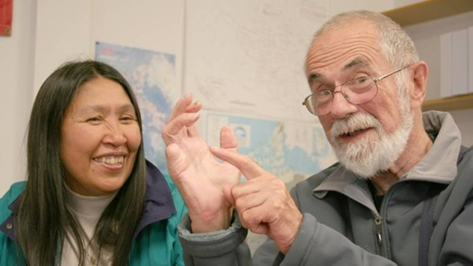
What was the most impactful for me: the “Strategic approach”
(1) picking the easiest dialect to learn
(2) picking the easiest script to learn
(3) following the “combined method” of both conversation and explicit grammar-based instruction
Mick Mallon & Alexina Kublu

Slide 8
…it goes against the ISL teaching approach which has become dominant post-Nunavut
The “strategic approach” isn’t revolutionary, but…
“Dominant approach”
(1) South Qikiqtaaluk/Baffin dialect
(2) syllabics
(3) “conversation-only” method

Slide 9
Dominant Approach v Strategic Approach
“iglu” is spelled “iglu”
“iglu-qaq-pit?” can be broken down into:
iglu (house) -qaq- (to have)
-pit? (do you?)
You don’t need to memorize the word, just the parts.
“illu” is spelled “ᐃᓪᓗ”
“illuqaqqit?” means “do you have a house?”
You need to memorize the full word.
And you can build new sentences, like
“qajaq-qaq-pit?”

Slide 10
Dominant approach
tries to balance competing goals beyond efficiency for learners
has worked for some learners in Northern/immersion settings
Andrew Morrison

Slide 11
But In southern/non-immersion settings…
Unclear that anyone has learned ISL using the dominant approach
The strategic approach may be more appropriate
What does this mean for urban ISL learners?
What does this mean for urban ISL teachers?

Slide 12
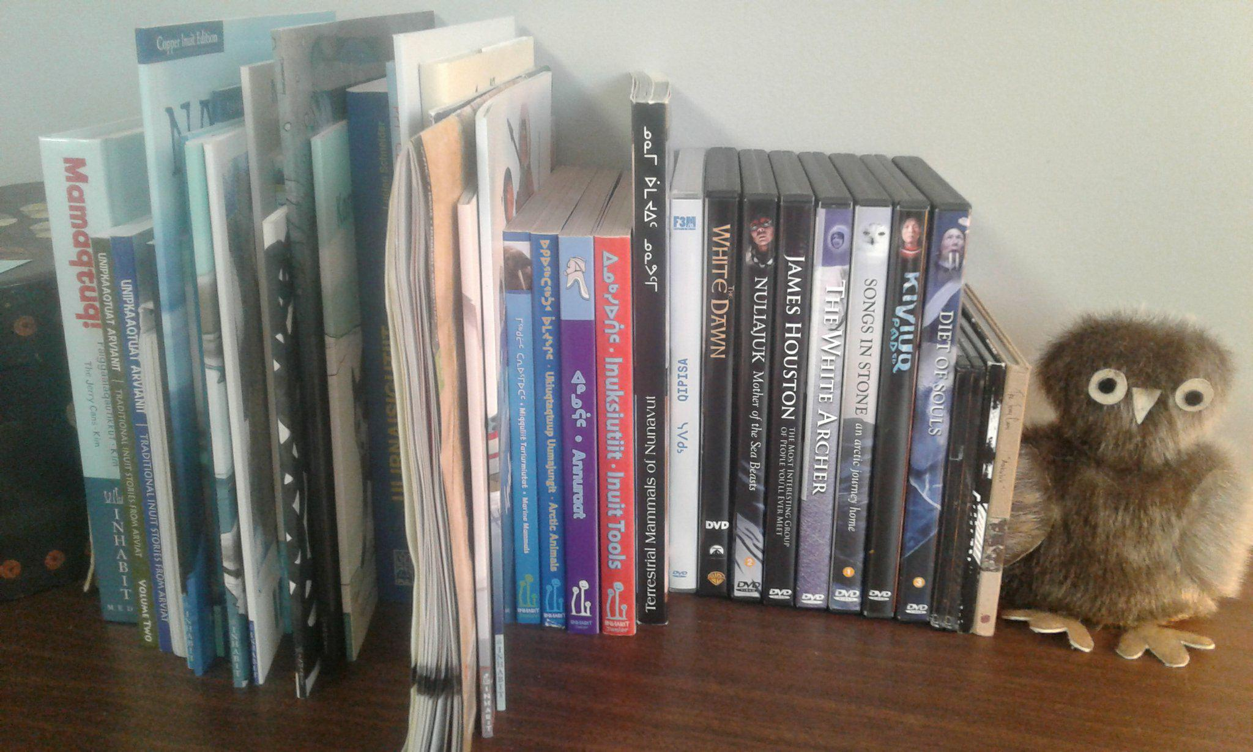
My own experience
1 year studying Mick Mallon’s textbooks and CD (Ottawa)
Structure of the language
1 year taking weekly online immersion classes (Thunder Bay)
Started as purely conversation-based (oral and written)
But then adopted strategic approach

Slide 13
What motivates me?
The language
“To have another language is to possess a second soul.” – Charlemagne
My partner
Raising a bilingual family in the future
As a woman

Slide 14
Pedagogical Questions to Consider for ISL Learners and Teachers
Does the language have a very different structure than English?
Is it an immersion or non-immersion setting?
What is the easiest dialect/script/learning method to use?
Is the dialect/script/learning method that has been chosen, appropriate in light of the setting?

Slide 15
“Uumajurniuti iniqunariaqajjangillaq.”
- Allatanga Zebedee Nungak
“A hunting implement need not be good-looking at all.”

Slide 16
Qujannamiik!

Slide 17
Apiqqutiksaq-qaq-pisi?
Do you have any questions?

Slide 18
sources
“An ephemeral anomaly. The metamorphoses of the Eskimo Language School: 1968-1999”, Mick Mallon
https://www.erudit.org/fr/revues/etudinuit/2005-v29-n1-2-etudinuit1430/013943ar.pdf
Pisusuuq, The One Who Walks
https://www.rte.ie/radio1/doconone/2017/0802/894699-pisusuuq-the-one-who-walks/
Our Language, Our Selves
http://www.nunavut.com/nunavut99/english/our.html
Inuktitut Magazine
https://www.itk.ca/wp-content/uploads/2016/10/2007-0102-InuktitutMagazine-IUCANS-IULATN-EN-FR.pdf

Slide 19
Inuktitut learning resources
Intermediate Inuktitut
Intermediate Inuktitut, Mick Mallon (1999)
Suffixes of the Eskimo Dialects of Cumberland Peninsula and North Baffin Island, Kenn Harper (1979)
Learning to Speak Inuktitut, Alex Spalding (1979)
Beginner Inuktitut
Introductory Inuktitut, Mick Mallon (1991)
Introduction to the Structure of Inuktitut (CD), Mick Mallon (2003) (free from Government of Nunavut)
Inuktitut Podcast Project, Ottawa Inuit Children’s Centre (online)
Tusaalanga website
Inuktitut Essentials: A Phrasebook, Pirurvik (2009)

