Slide 1
Working with the Blackfoot Language Resources website in the classroom https://blackfoot.atlas-ling.ca
Inge Genee
Department of Modern Languages
University of Lethbridge
Inge.genee@uleth.ca

Slide 2
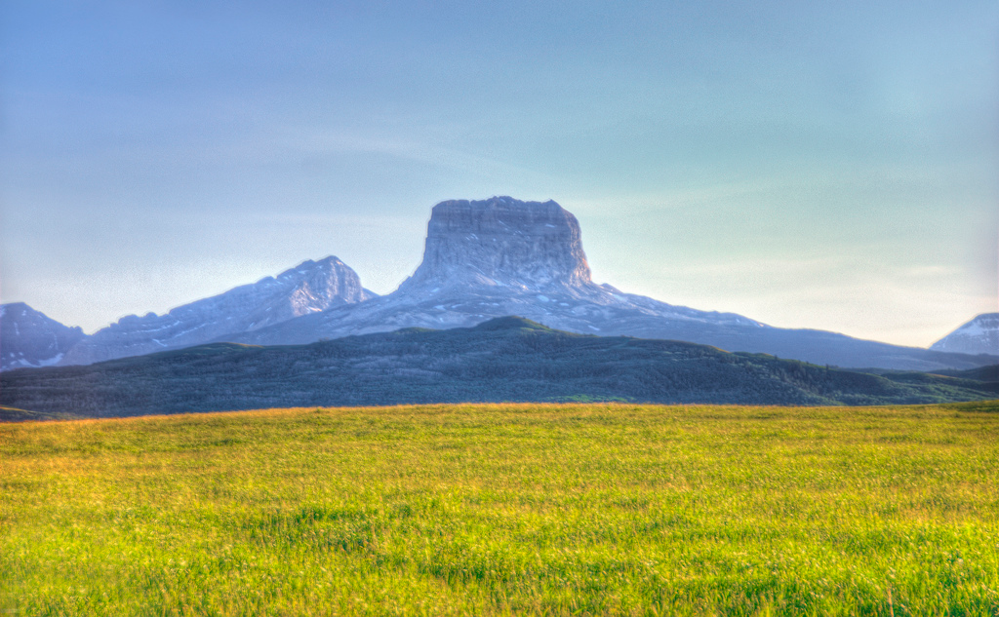
Contributors
Steffi Becker Dudley Jessie Black Water Kim Black Water Heather Bliss Peter Chief Calf Natalie Creighton Shirlee Crow Shoe Francis First Charger Don Frantz Inge Genee Kristen Healy Rachel Hoof Beverly Hungry Wolf Janine Jackson Shelby Johnson Marie-Odile Junker Philomena Melting Tallow Madoka Mizumoto Mizuki Miyashita Madeline Neufeld Dan O’Donnell Claire Owen Mahaliah Peddle Peter Pankonin Nicole Rosen Blaise Russell Meagan Schritt Myles Shirakawa Amanda Thom Carl Singer Shawn Singer William Singer III Delasie Torkornoo Natalie Weber Brittany Wichers Jo Ann Yellow Horn Pauline Yellow Horn Fernando Zúñiga

Slide 3
Origin of project: Back-digitization of database for existing dictionary

Slide 4
Goal: Make a user-friendly resource for speakers, learners and teachers

Slide 5
Result: Blackfoot Language Resources project website

Slide 6
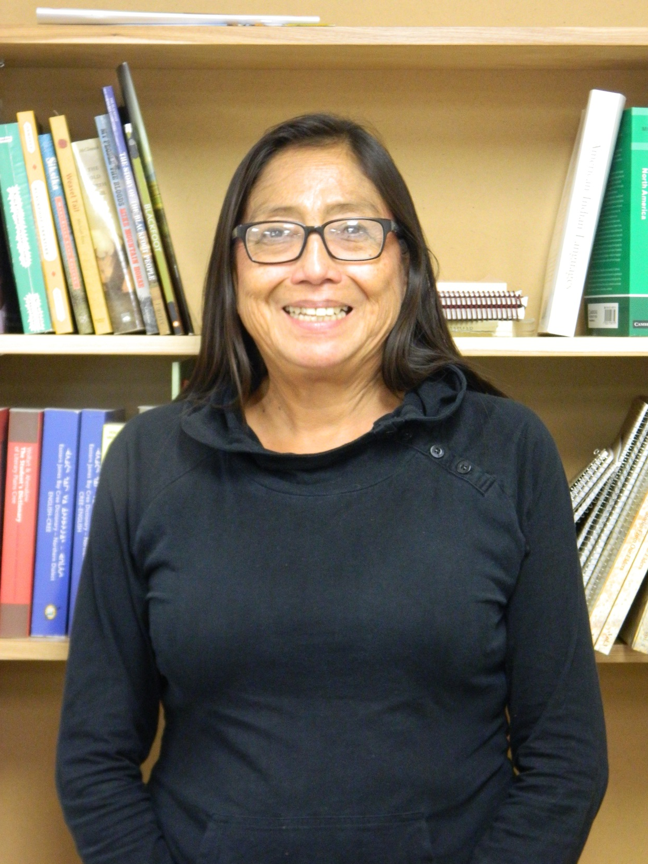
Current features of website
Dictionary
Grammar pages
Story archive
Resource pages
Contributors pages
Copyright statement

Slide 7
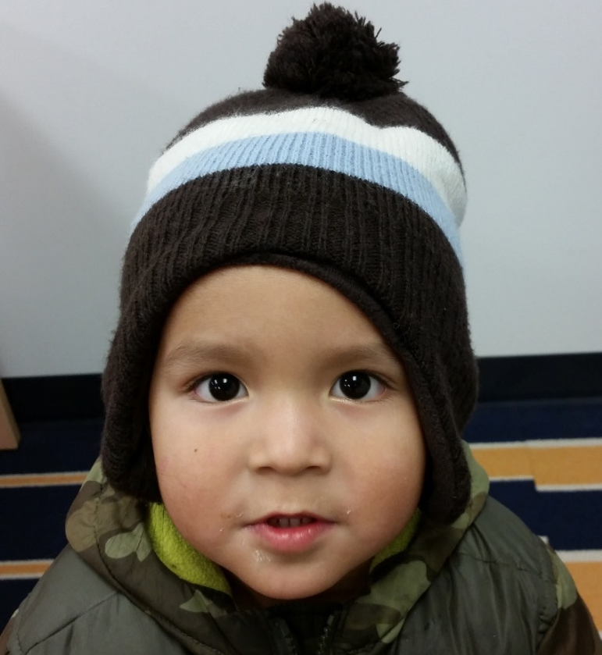
Dictionary features
Help videos
List of abbreviations
English-to-Blackfoot search
Blackfoot-to-English search
Relaxed search
Advanced search options
Pictures, sound files, examples,
Micro videos
Browse features

Slide 8
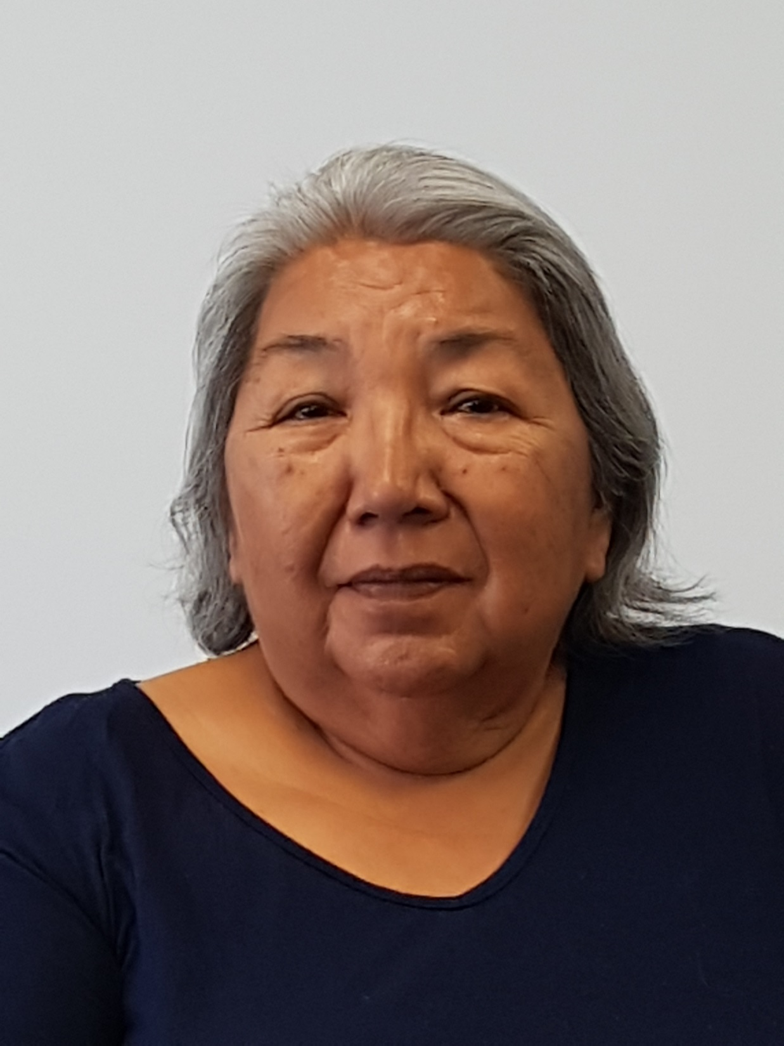
Grammar pages
Grammar points – nouns
Paradigms – nouns
Paradigms – verbs
Includes audio
Work in progress!
We keep adding to this
part of the website

Slide 9
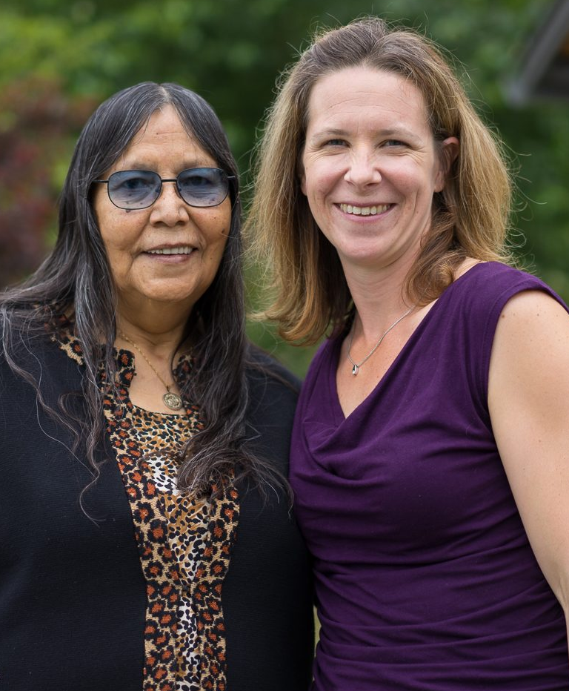
Story archive
Fifteen storytellers
Search by dialect
Search by storyteller
Search by genre
Audio in Blackfoot with
English translation

Slide 10
Resource pages
Blackfoot linguistics
Grammars and dictionaries
Websites
Language learning resources
Apps
Other resources
Send us updates if you learn about new things, especially apps and on-line resources

Slide 11
Putting Blackfoot on the map: Algonquian Linguistic Atlas

Slide 12
Features on the Algonquian Linguistic Atlas
Listen to short phrases in Siksika, Piikani and Kainai dialect
Phrases organized in Themes such as Family, Greeting, Numbers, Days, Weather etc.
Download selections to make your own MP3 file for practice.
MP3 files can also be used to compare dialects.

